Slide 1
DATA TYPE
Md. Yunus Abedin
Data Management Assistant
Nutrition Research Division
Solving public health problems through innovative scientific research
www.icddrb.org

Slide 2

Presentation outline
What is data and information
Data and its classification
2

Slide 3
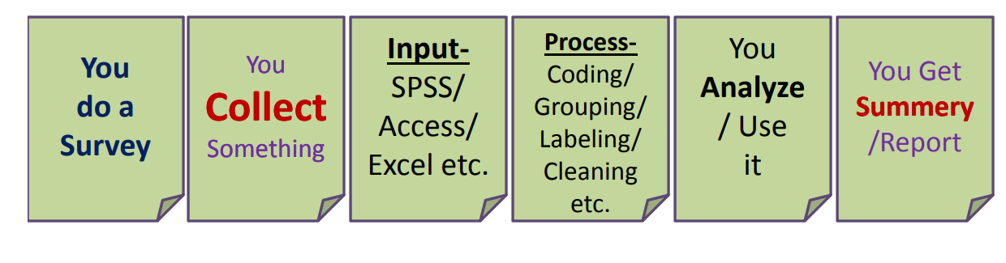
In a research
3

Slide 4

So what you collect?
4

Slide 5
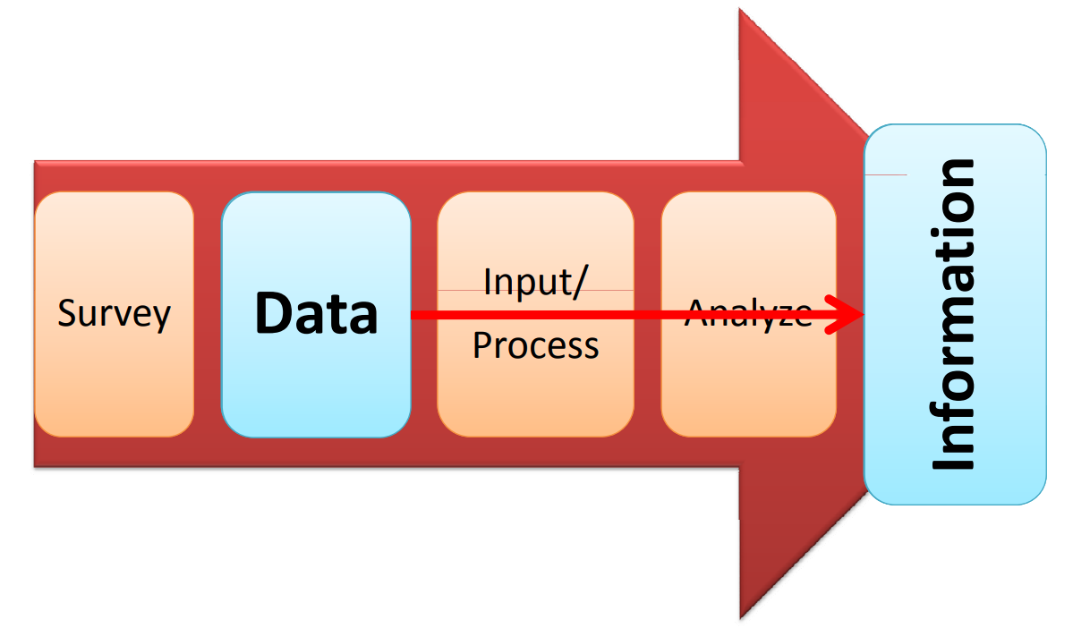
Short Review on Epidemiology
What Is SCIENTIFIC METHOD?
5

Slide 6
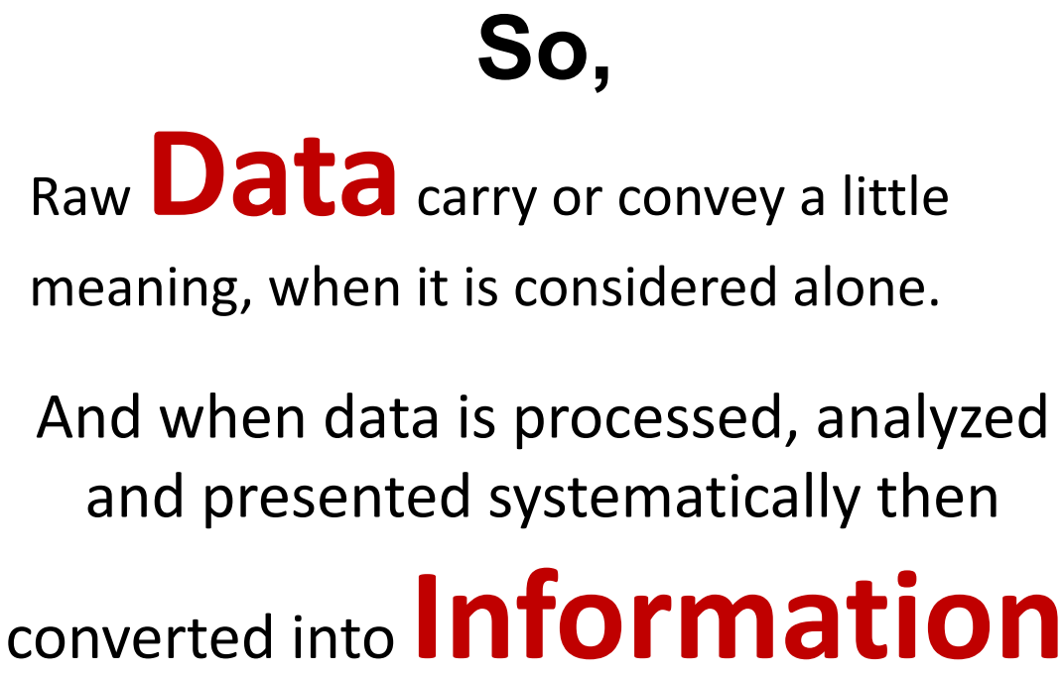
6

Slide 7
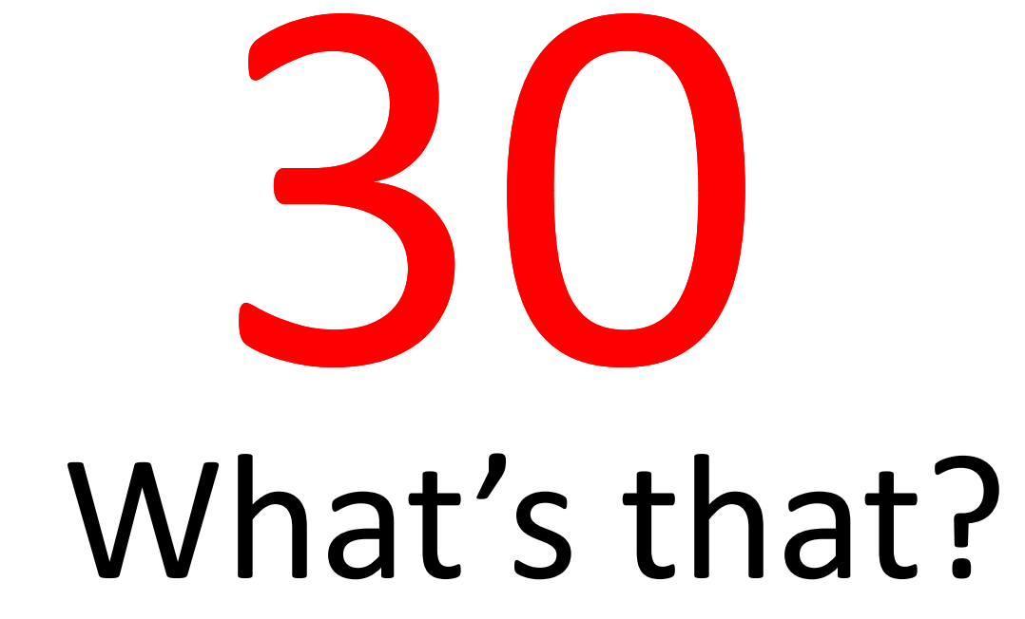
7

Slide 8
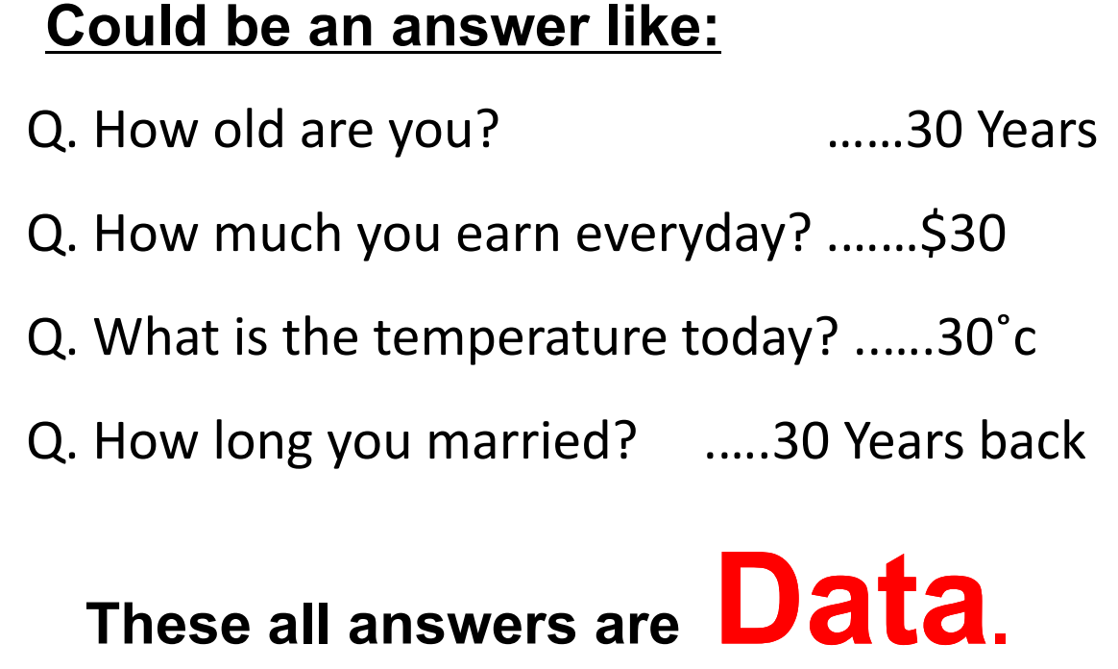
8

Slide 9
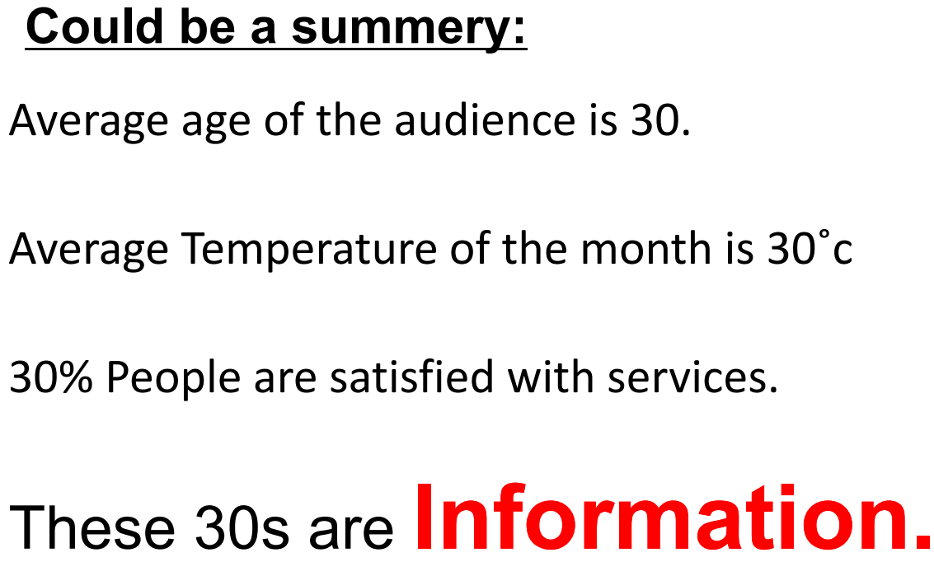
9

Slide 10
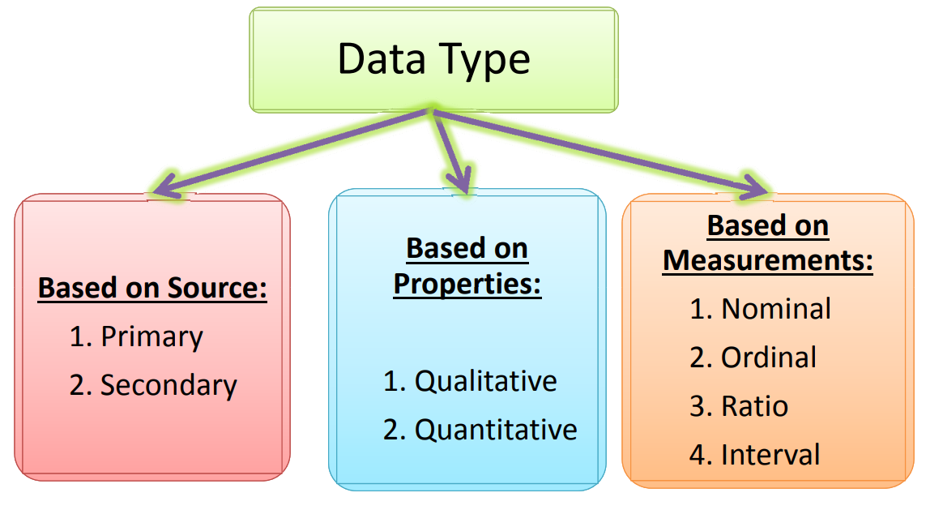
10

Slide 11
Primary data
Original
First‐hand information
You collect it for your own research
Specific to your needs
More insights in any specific issue
Collection Procedure : Through interviews, Observation, Case Studies, Questionnaires
11

Slide 12
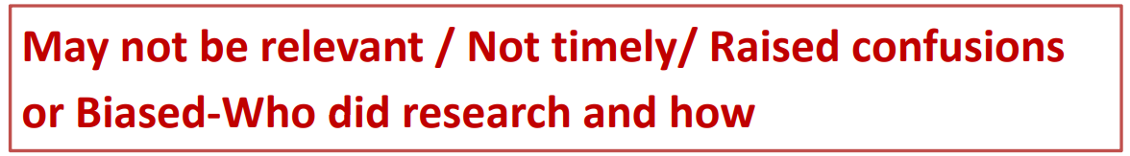
Secondary data
Someone collected and publihed previously and you are using
(We re‐use)
Saves Time
Saves Money/Saves Man Hours
Collection Procedure : Government Agencies(e.g.BBS),Academic Journals, Research Institutions, International Organization(e.g. World Bank, WHO)
12

Slide 13
13

Slide 14
Qualitative Data
Data that describes qualities, characteristics, or attributes rather than numbers.
It answers questions like “What? Why? How?” instead of “How many?” or “How much?”
Usually expressed in words, images, or symbols rather than numeric values.
Collection Procedure : Interviews, Focus groups, Observations, Case studies, Document analysis
Example : Interview transcripts, Social media comments, Photos, Videos, Open ended survey response, Smell, Emotion, Beauty
14

Slide 15
Quantitative Data
Quantitative data is numeric information that can be measured, counted, and analyzed statistically
It answers questions like “How many?”, “How much?” or “How often?”
Data collection procedure:
Surveys with close-ended questions (e.g., Yes/No, Likert scales).
Experiments (scientific measurements).
Observations with numeric recording (e.g., frequency counts)
Databases & official statistics (government, company records)
Example : Age, Height, Weight, Exam Scores, Income, Number of customers visiting a store
15

Slide 16
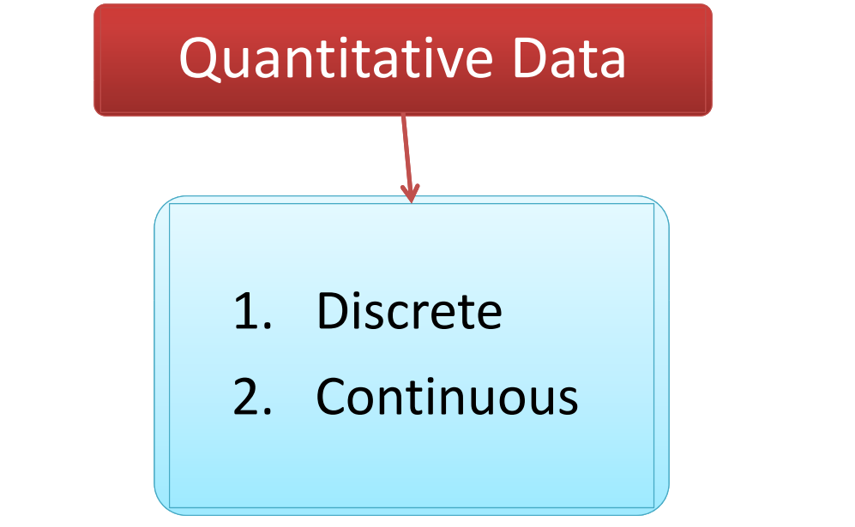
16

Slide 17
Discrete data
Consists of countable, separate, and distinct values
Represents whole numbers
Values cannot be divided into smaller meaningful parts
No fraction or decimals
Gap exist between values
Finite or countable infinite
Example : Number of children in a family(e.g. 2,3,4,5,6 or 7….)
Number of cars, Number of students, Number of rice in a pot , Show size, etc.
17

Slide 18
Continuous data
Measurable that means It is usually obtained through measurement rather than counting
Can take infinite possible values within a range
Decimals/fractions are possible (e.g., 5.3 kg, 2.75 hours)
No gaps between values → values are continuous
Example: Height of a person (170.2 cm), Weight of a bag (12.75 kg), Time taken to run a race(5.98 sec), Temperature (36.6°C), Distance between two cities (325.4 km)
18

Slide 19
🔹 Discrete vs Continuous (Quick Comparison)
Feature | Discrete Data | Continuous Data
Nature | Countable | Measurable
Possible Values | Whole numbers only | Any value (fractions/decimals allowed)
Examples | Number of students, goals scored | Height, weight, time, temperature
19

Slide 20
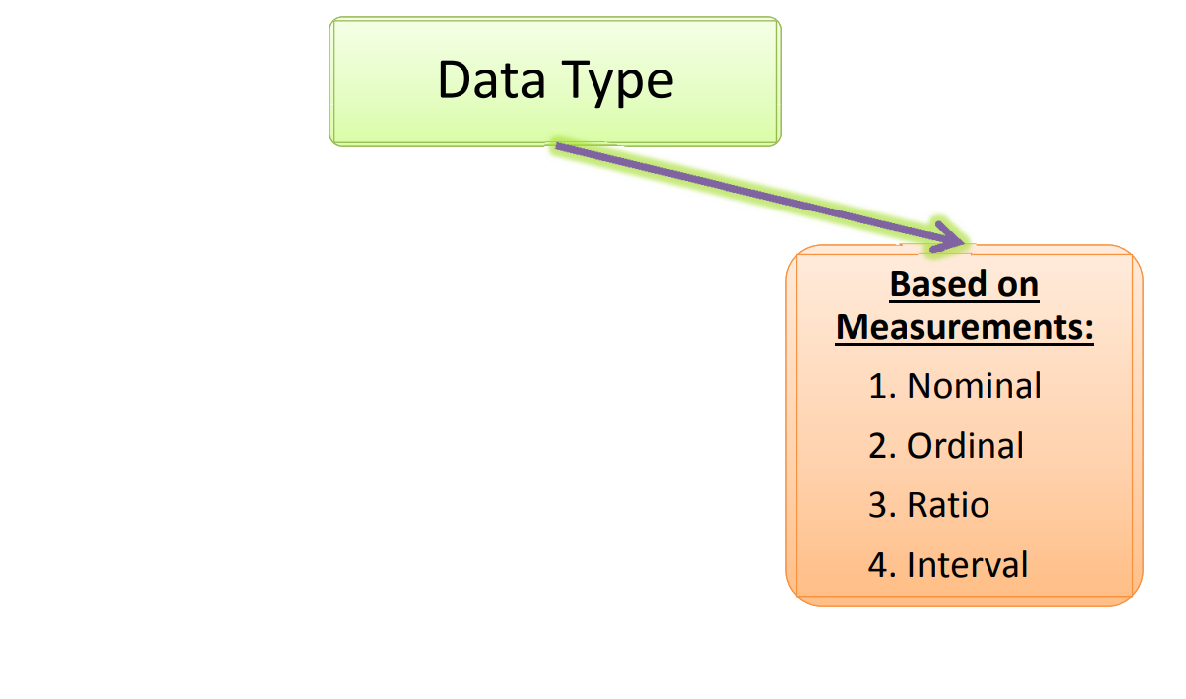
20

Slide 21
🔹 Scales of Measurement in Statistics
Scale | Nature of Data | Examples | Order? | Equal Intervals? | True Zero? | Allowed Statistics
Nominal | Categories / Labels | Gender, Blood type, Colors | ❌ No | ❌ No | ❌ No | Mode, Frequencies
Ordinal | Ordered Categories | Satisfaction level, Education level | ✅ Yes | ❌ No | ❌ No | Median, Percentiles
Interval | Numeric, equal spacing | Temperature (°C, °F), IQ, Years | ✅ Yes | ✅ Yes | ❌ No | Mean, Std. Deviation
Ratio | Numeric, equal spacing, true 0 | Weight, Height, Age, Income | ✅ Yes | ✅ Yes | ✅ Yes | All statistics
21

Slide 22
Other classification
Cross-sectional Data → Collected at one point in time (e.g., survey in 2025)
Time Series Data → Collected over time (e.g., stock prices daily, rainfall monthly)
Panel Data → multiple subjects (individuals, firms, countries, etc.) over multiple time periods.
Structured Data → Organized, fits into rows/columns (e.g., Excel spreadsheet)
Unstructured Data → Free form, not easily organized (e.g., videos, emails, images)
Semi-structured Data → Mixed format (e.g., JSON, XML files)
22

Slide 23
Other classification cont.
🔹 Cross-sectional VS Time series VS Panel data
Feature | Cross-sectional | Time-series | Panel Data (Longitudinal)
Dimension | One point, many entities | One entity, many times | Many entities, many times
Focus | Variation across subjects | Trend over time | Both variation across & within entities
Example | Education level of 500 people in 2025 | Stock price of Apple (2010–2025) | Stock prices of 50 companies (2010–2025)
23

Slide 24
Other classification cont.
🔹 Structured VS Semi structured VS Unstructured Data
Feature | Structured Data | Semi-Structured Data | Unstructured Data
Format | Organized in rows & columns | Some organization with tags/keys | No predefined format
Storage | Relational databases (SQL) | NoSQL DBs, JSON/XML, data lakes | Data lakes, file systems, Hadoop, cloud
Examples | Bank records, customer info, sensor logs | JSON, XML, emails, HTML, log files | Text documents, images, audio, video, social media posts
24

Slide 25
Thank you
icddr,b thanks its core donors for their on-going support

